Slide 1
AZ-220T01 Module 1: Introduction to IoT and Azure IoT services

Slide 2
Lesson 1: Learning objectives

Slide 3
Module 1 – Learning objectives
Describe the core components of an Azure IoT solution architecture
Describe the Azure IoT services and how they contribute to an IoT solution
Create an azure account and use the Azure portal to create an IoT hub and device provisioning service
Notes:
A courseware goal for this module is to be relatively high-level and quick. This does not mean “rushed,” but it does mean to avoid deep dives and ratholes as the rest of the course will present plenty of more appropriate opportunities for these.
You might find a “parking lot” useful here for any deep dives that you deflect to make sure you loop back to them later in the course where appropriate.
We’ve geared things towards the developer side, but it’s very possible that architects and data analysts will be in the room. They are not the target audience, but this module, as much as the student introductions, should tell you this. This content should be consumable by all of those groups, although labs may be a bit difficult for some.

Slide 4

Lesson 2: Introduction to IoT solution architecture

Slide 5
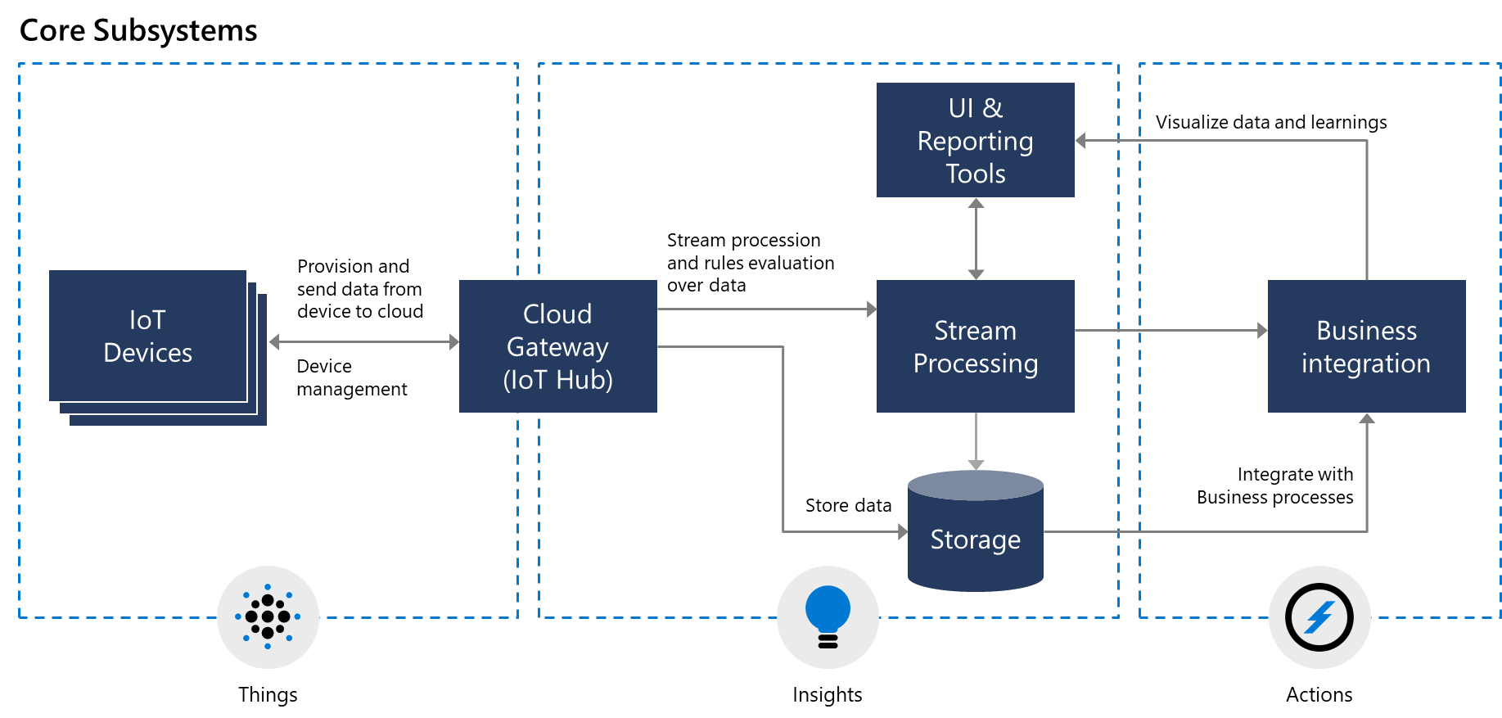
Core subsystems of an IoT architecture
Notes:
This is the high-level architecture. Feel free to walk through the components quickly for the presentation of this slide – there’s going to be more details later. For now we’re just presenting the big picture.
Make sure you explain the Cloud Gateway is critical:
“A key part of the architecture is the cloud gateway role… this is defined in the Microsoft documentation as ‘… a central message hub for bi-directional communication between your IoT application and the devices it manages.’”

Slide 6
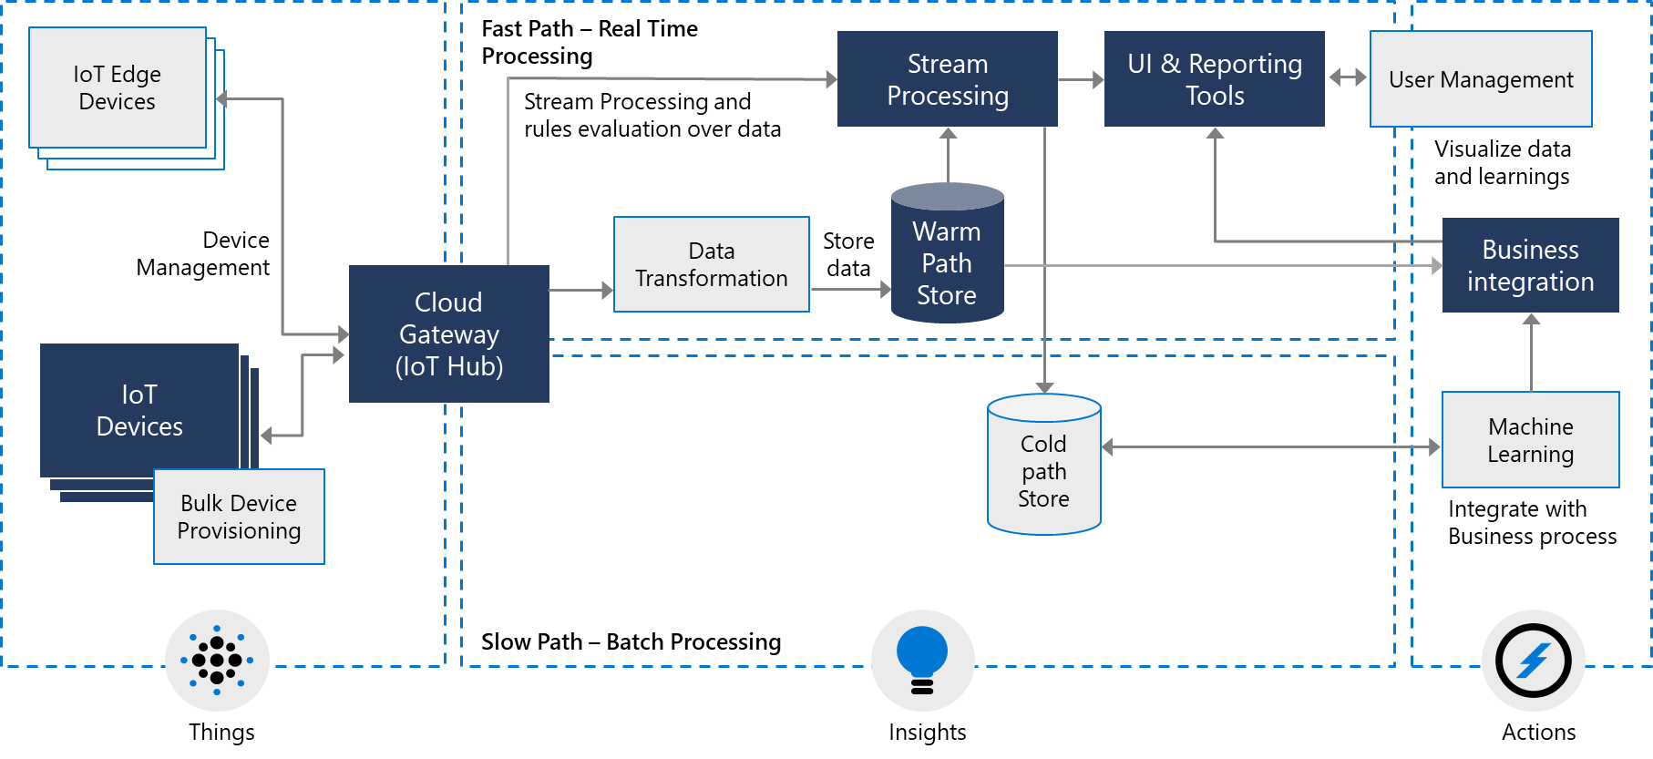
Optional subsystems of an IoT architecture
Notes:
This is an expanded architecture, bringing in optional subsystems within the reference architecture. (That same term is used in the SkillPipe.) This is also intended to be a quick walk-through, not a deep dive.
You may want to start mentioning Azure specific components here, or at least mention that we are going to specifically call out solutions later.
Azure IoT in Docs : https://docs.microsoft.com/en-us/azure/iot-fundamentals/iot-introduction
Azure IoT Reference Architecture in Docs : https://docs.microsoft.com/en-us/azure/architecture/reference-architectures/iot/
Azure IoT Reference Architecture PDF : http://download.microsoft.com/download/A/4/D/A4DAD253-BC21-41D3-B9D9-87D2AE6F0719/Microsoft_Azure_IoT_Reference_Architecture.pdf

Slide 7

Data flow and processing
An IoT solution is all about the data… Data is generated by things, is processed and analyzed to generate insights, and these insights lead to actions…
Things – Generate Data
Insights – Based on Data Generated
Actions – Based on Insights
Notes:
This slide sets up future parts of the course, where we tackle different parts of the data flow – we’re “planting the seed” for those topics. You should reference that we’re going to talk about these topics later. This also can be seen as a “hey, data analysts? We see you!” slide.
The concept of things (devices) feeding data to find business insights to generate actions is a critical part of how the Microsoft tools are designed and intended to fit together. This concept is going to come up again and again through the course, so we’re introducing it here.
A key point is that this is not specific to a business vertical – it’s a general design that isn’t specific to any particular customer or business area. It’s not like having a desktop app vs. a mobile app, where you are changing the high level fundamental design in many cases.
Storage includes in-memory caches, temporary queues and permanent archives (e.g. a database).
Routing allows sending data records to one or more storage endpoints, analysis processes, and actions. Routing makes decisions on what data should go which target and when.
Analysis is used to run data records through a set of conditions and can produce different output data records. For instance, input telemetry data encoded in one format may return output telemetry encoded in another format.
Original input data records and analysis output records are typically stored and available to display, and may trigger actions such as emails, instant messages, incident tickets, CRM tasks, device commands, etc.

Slide 8
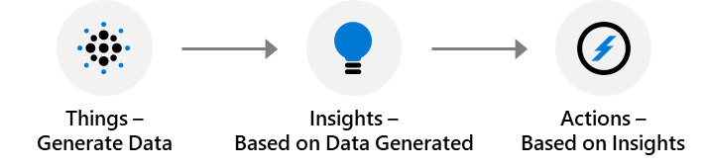
Data flow and processing
An IoT solution is all about the data… Data workflows include routing, storage, analysis, and eventually actions or reports…
Routing makes decisions on what data should go to which target and when
Storage includes different locations for different needs
Analysis transforms inputs to outputs to produce insights while maintaining the original data
Actions/Displays report on the data and trigger actions (tasks) based on the data, either pre-analysis or post-analysis
Notes:
This slide sets up future parts of the course, where we tackle different parts of the data flow – we’re “planting the seed” for those topics. You should reference that we’re going to talk about these topics later. This also can be seen as a “hey, data analysts? We see you!” slide.
Storage includes in-memory caches, temporary queues and permanent archives (e.g. a database).
Routing allows sending data records to one or more storage endpoints, analysis processes, and actions. Routing makes decisions on what data should go which target and when.
Analysis is used to run data records through a set of conditions and can produce different output data records. For instance, input telemetry data encoded in one format may return output telemetry encoded in another format.
Original input data records and analysis output records are typically stored and available to display, and may trigger actions such as emails, instant messages, incident tickets, CRM tasks, device commands, etc.

Slide 9
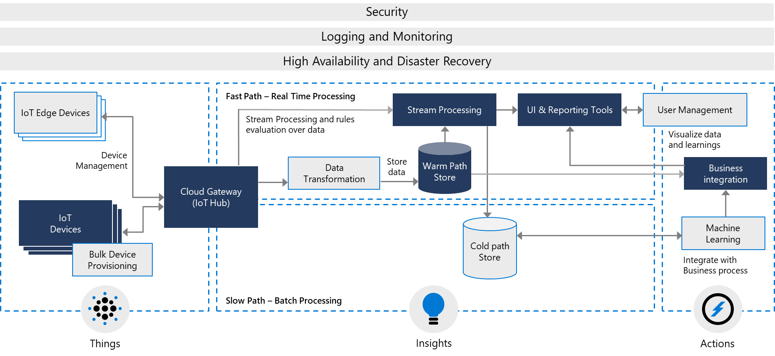
Cross-cutting architectural needs
Notes:
“In addition to the individual components, there are cross-cutting architectural needs that impact the full solution…”
Security considerations will be addressed throughout the course as they apply to specific tasks or Azure services. In addition, end-to-end security considerations and tools that support a broader security consideration will be covered within a module near the end of the course.
The implementation of monitoring and logging, along with troubleshooting tasks and considerations, will be covered in a module near the end of the course.
High-availability and disaster recovery will not be addressed beyond the context of individual Azure services within this course because these topics tend to be the responsibility of a separate job role (not the IoT developer).
Again, we’re presenting the architecture at a high level but will be bringing up the pieces later.

Slide 10
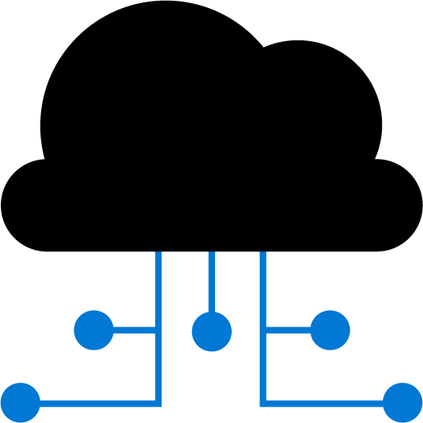
Lesson 3: IoT hardware and cloud services

Slide 11
IoT hardware components
IoT devices:
IP-enabled devices
Non-IP enabled devices
IoT edge devices
Other IoT hardware
Notes:
While most people assume IoT means IP-enabled, remember from earlier that IoT does not require devices to have direct IP or Internet connectivity. A non-IP device using Bluetooth, Zigbee, etc. can communicate with an IoT Edge device that has Internet connectivity.
“Other IoT Hardware” includes network switches and routers, specialized protocol gateways, etc. Some students may have smart home devices today with gateway hubs that fall into this category.

Slide 12


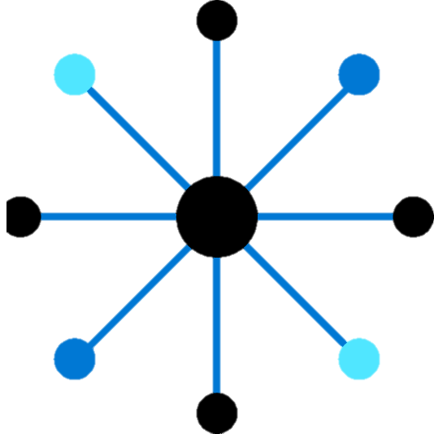
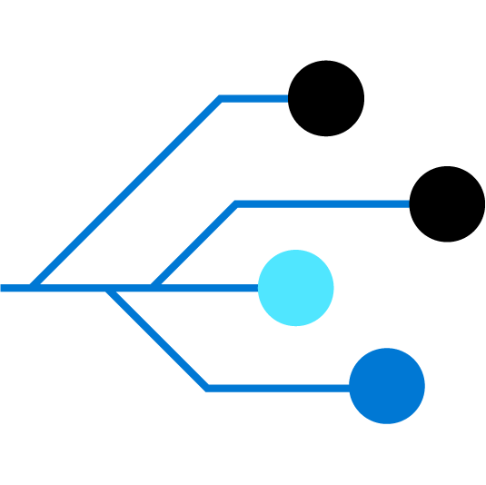
Azure IoT technologies, services, and solutions
Azure Defender for IoT
IoT Central application templates
Retail
Health
Energy
Government
IoT Solutions
Azure IoT Central – managed application platform
Reference Architecture and Accelerators (PaaS)
Dynamics Connected
Field Service (SaaS)
Azure Services for IoT
Azure IoT Hub Device
Provisioning Service
Azure Digital Twins
Azure Time series Insights
Azure Maps
Azure Stream Analytics
Azure Cosmos DB
Azure AI
Azure Cognitive Services
Azure ML
Azure Logic Apps
Azure Active Directory
Azure Monitor
Azure DevOps
Power BI
Azure Data Share
Azure Spatial Anchors
IoT and Edge
Device Support
Azure Sphere
Azure IoT Device SDK
Azure IoT Edge
Azure Data Box Edge
Windows IoT
Azure Certified for IoT – Device Catalog
Azure Stream Analytics
Azure Storage
Azure ML
Azure SQL
Azure Functions
Azure Cognitive Services

Slide 13
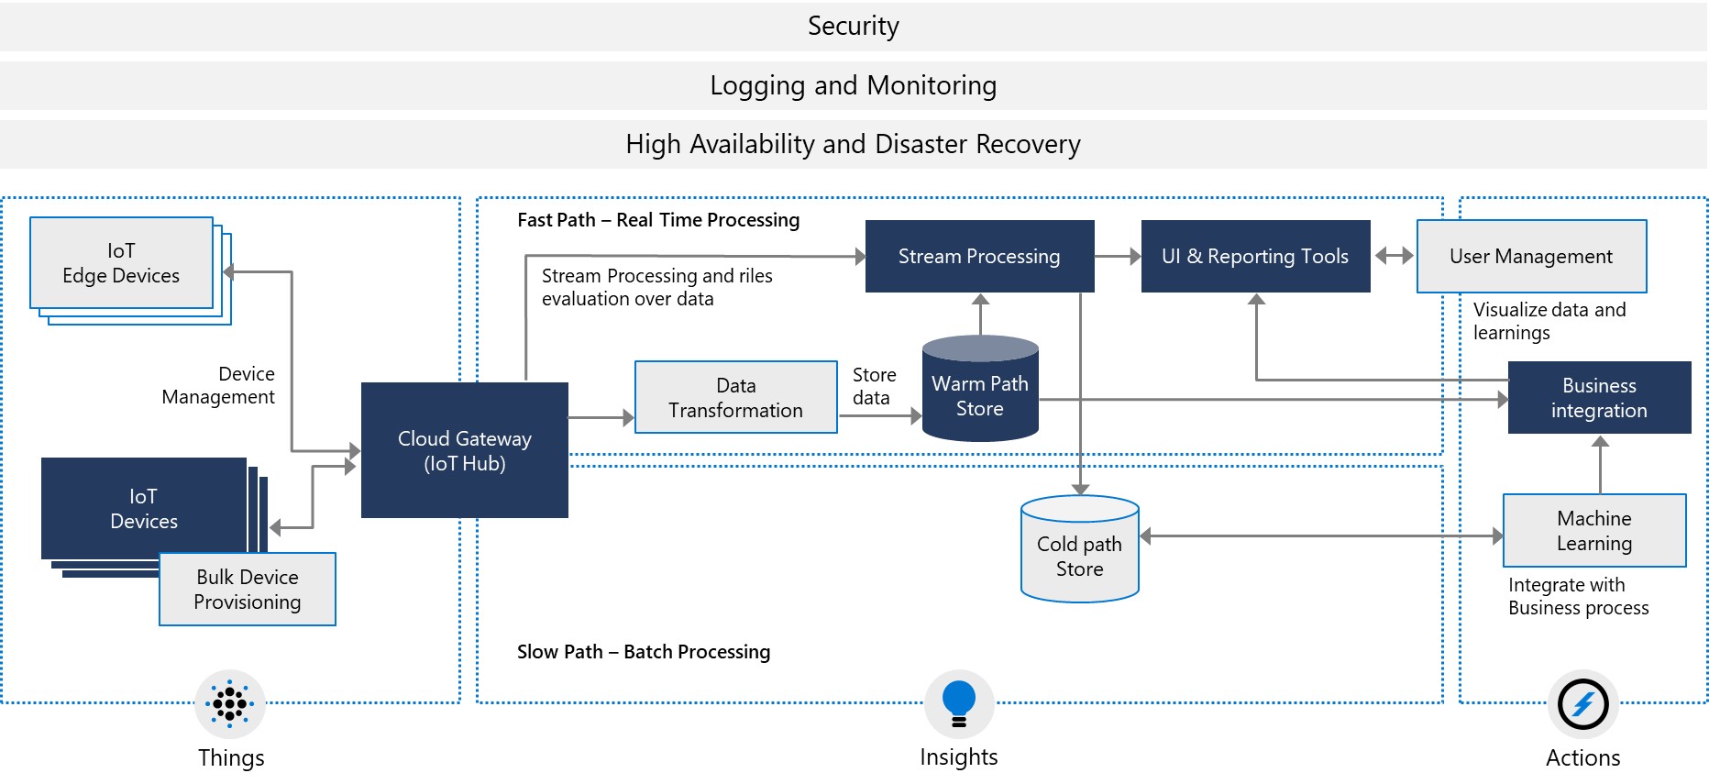
Microsoft offerings
Notes:
“We’re next going to look at some specifics from the completed architecture diagram from before. We’re not going through each piece here, just some of the high-level pieces. [click] We’re going to start with the IoT Devices…”

Slide 14
Introduction to IoT device software
OS Support:
Programming Language Support:
Windows 10 IoT
Ubuntu Core
C/C++
Java
Riot
QNX
C#
Python
Android Automotive
etc.
etc.
Software Development Kits:
Device SDKs
Service SDKs
Device Provisioning SDKs
Notes:
The only entry on here that may not be self-evident is the breakdown of the SDKs. Microsoft provides SDKs in all three categories. The topic to emphasize here is the SDKs topic – but note we deep dive on the three categories later.
Microsoft provides a number of IoT SDKs (https://docs.microsoft.com/en-us/azure/iot-hub/iot-hub-devguide-sdks) that range across a variety of languages and devices and are designed to provide the software and services needed to accelerate your solution development. The company breaks down their SDKs into three categories:
Device SDKs enable you to build apps that run on your IoT devices using device client or module client. These apps send telemetry to your IoT hub, and optionally receive messages, job, method, or twin updates from your IoT hub. You can also use module client to author modules for Azure IoT Edge runtime. The device SDK comes in the following platform flavors: .NET, C, Java, Node.js, Python, and iOS.
Service SDKs enable you to manage your IoT hub, and optionally send messages, schedule jobs, invoke direct methods, or send desired property updates to your IoT devices or modules.
Device Provisioning SDKs enable you to provision devices to your IoT Hub using the Device Provisioning Service.

Slide 15

Microsoft offerings
Notes:
“Next, we’ll look at the Azure IoT Hub, the Microsoft Cloud Gateway offering…”

Slide 16
Features of Azure IoT Hub
Azure IoT Hub provides feature support in the following areas:
Security
Scalability
Routing
Service Integration
Device management
Monitoring

Slide 17

Microsoft offerings
Notes:
“And last, for now at least, we’re going to mention the Azure IoT Hub Device Provisioning Service, or DPS…”

Slide 18
Features of Azure IoT Hub Device Provisioning Service
Features of the Device Provisioning Service include:
Secure attestation
Enrollment list
Allocation policies
Monitoring
Multi-hub support

Slide 19
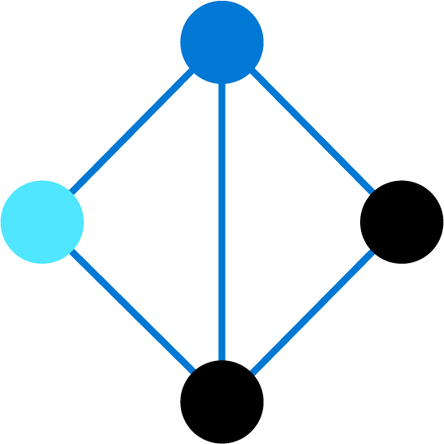
Lesson 4: Course lab scenario

Slide 20
Scenario overview
Contoso – cheese manufacturing and shipping:
Monitor product temperature and humidity in the factory and warehouses
Monitor vehicles during shipping
Support factory equipment
Your role as an Azure IoT developer:
Device configuration and lifecycle management
Support data analytics and architect roles
Implement Azure IoT Edge scenarios

Slide 21
Lab naming and region
Resource group name is specific and given in the lab
Azure resources (IoT Hub, DPS, etc.) will be assigned unique names when required by applying a Unique ID {your-id} composed of your initials plus YYMMDD, e. g. “iot-az220-training-cah191216”
Everything should be in the same region

Slide 22
Lesson 5: Module 1 labs

Slide 23
Module 1 labs
Lab 1: Getting started with Azure:
You will explore the Azure portal and examine some ways that you can customize the UI
You will create a custom dashboard that you can use during this course and populate it with a resource group tile
Lab 2: Getting started with Azure IoT services:
You will use the Azure portal to create an IoT Hub resource
You will use the Azure portal to explore the features and capabilities of your new IoT Hub
You will use the Azure portal to create an instance of the IoT Hub Device Provisioning Service
You will link your IoT Hub and Device Provisioning Service
You will use the Azure portal to explore the features and capabilities of your new Device Provisioning Service

Slide 24
Lesson 6: Module review questions

Slide 25
Module review: Question 1.1
You have been asked to join a team that will be working on an IoT solution for your company. You begin by reviewing a high-level reference architecture diagram for the proposed IoT solution. You see “cloud gateway” listed on the diagram
What is the primary purpose of the cloud gateway? (choose one best answer)
Answer A:
It facilitates the execution of actions based on insights garnered from device telemetry data during stream processing
Answer B:
It provides secure connectivity, telemetry and event ingestion, and device management capabilities
Answer C:
It provides operational information and displays reports through a browser interface
Answer D:
It gathers input values from connected sensors and sends telemetry to the cloud
Answer E:
It provides immediate and long-term access to telemetry data
Notes:
Correct Answer: B
Explanation:
In the student workbook/skillpipe content, topic Subsystems of an IoT Architecture includes the following:
IoT Devices: The physical devices where our data originates.
Cloud Gateway: The Cloud Gateway provides a cloud hub for secure connectivity, telemetry and event ingestion and device management (including command and control) capabilities.
User Interface and Reporting: The user interface for an IoT application can be delivered on a wide array of device types, in native applications, and browsers.
Stream Processing: Processes large streams of data records and evaluates rules for those streams.
Storage: Storage can be divided into warm path (data that is required to be available for reporting and visualization immediately from devices), and cold path (data that is stored longer term and used for batch processing).
Business Process Integration: Facilitates executing actions based on insights garnered from device telemetry data during stream processing. Integration could include storage of informational messages, alarms, sending email or SMS, integration with CRM, and more.

Slide 26
Module review: Question 1.2
You have been asked to join a team that will be working on an IoT solution for your company. You know that security is an important consideration. When you review the proposed architecture diagram, you don’t see security listed
Where should security be called out on the architecture diagram? (choose one best answer)
Answer A:
Security is associated primarily with devices and should appear on the device side of the diagram
Answer B:
Security is associated primarily with communication between the Cloud Gateway and the other services/ devices and should appear next to Cloud Gateway on the diagram
Answer C:
Security is associated primarily with data storage and retrieval and should appear next to storage on the diagram
Answer D:
Security is associated with all subsystems of the solution and should appear across the top of the diagram
Answer E:
Security is associated primarily with cloud services and should appear on the cloud side of the diagram
Notes:
Correct Answer: D
Explanation:
In the student workbook/skillpipe content, topic Cross-Cutting Architectural Concerns includes the following:
There are multiple cross-cutting needs for IoT solutions that are critical for success, including: 1) security requirements; including user management and auditing, device connectivity, in-transit telemetry, and at rest security, 2) logging and monitoring for an IoT cloud application is critical for determining health and for troubleshooting failures both for individual subsystems and the application as a whole, and 3) high availability and disaster recovery which is used to rapidly recover from systemic failures.
Security: Security is a critical consideration in each of the subsystems. Protecting IoT solutions requires secure provisioning of devices, secure connectivity between devices, edge devices, and the cloud, secure access to the backend solutions, and secure data protection in the cloud during processing and storage (encryption at rest).
Logging and monitoring: Logging actions and monitoring activity associated with your IoT solution is critical for determining system uptime and troubleshooting failures.
High availability and disaster recovery: High availability and disaster recovery (HA/DR) focuses on ensuring an IoT system is always available, including from failures resulting from disasters. The technology used in IoT subsystems have different failover and cross-region support characteristics. For IoT applications, this can result in requiring hosting of duplicate services and duplicating application data across regions depending on acceptable failover downtime and data loss.

Slide 27
Module review: Question 1.3
You have been asked to join a team that will be working on an IoT solution for your company. Your team is small and will need a fully managed SaaS solution that can be started quickly and operated with minimal IoT experience. You are asked to help choose one of the Microsoft Azure offerings for IoT
Which of the Microsoft offerings should you recommend? (choose one best answer)
Answer A:
IoT Hub, IoT Hub Device Provisioning Service, Stream Analytics, and Cosmos DB
Answer B:
IoT Hub, Stream Analytics, and Cosmos DB
Answer C:
IoT Hub, Stream Analytics, and Azure Storage
Answer D:
IoT Central
Notes:
Correct Answer: D
Note: Although Microsoft documentation no longer refers to IoT Central as a SaaS offering, it does meet the definition for SaaS and the SaaS/PaaS distinction may be helpful to some students as these products are introduced.
Explanation:
In the student workbook/skillpipe content, topic Azure IoT Services and Technologies includes the following:
Azure IoT Central (SaaS)
The IoT Central application platform reduces the burden and cost of developing, managing, and maintaining enterprise-grade IoT solutions. IoT Central's customizable web UI in lets you monitor device conditions, create rules, and manage millions of devices and their data throughout their life cycle. The API surface within IoT Central gives you programmatic access to configure and interact with your IoT solution.
Azure IoT Central is a fully managed application platform that you can use to create custom IoT solutions. IoT Central uses application templates to create solutions. There are templates for generic solutions and for specific industries such as energy, healthcare, government, and retail. IoT Central application templates let you deploy an IoT Central application in minutes that you can then customize with themes, dashboards, and views.
Technologies (PaaS)
With the most comprehensive IoT portfolio of platform services, Platform-as-a-Service (PaaS) technologies that span the Azure platform enable you to easily create, customize, and control all aspects of your IoT solution. Establish bi-directional communications with billions of IoT devices and manage your IoT devices at scale. Then integrate your IoT device data with other platform services, such as Azure Cosmos DB and Azure Time Series Insights, to enhance insights across your solution.
IoT Hub
Azure IoT Hub is a fully managed service that enables reliable and secure bidirectional communications between millions of IoT devices and a solution back end. The Azure IoT Hub Device Provisioning Service is a helper service for IoT Hub that enables zero-touch, just-in-time provisioning to the right IoT hub without requiring human intervention, enabling customers to provision millions of devices in a secure and scalable manner.

Slide 28
Module review: Question 1.4
You have joined a team that is developing an IoT solution for your company. You will be implementing IoT Hub, the IoT Hub Device Provisioning Service, Azure Stream Analytics, Azure Storage, and Time Series Insights. You need to understand the features and capabilities of IoT Hub
Which of the following are features of IoT Hub? (choose all correct answers)
Answer A:
Provides control over device access by using resource groups
Answer B:
Provides individual X.509 certificate authentication for secure, standards-based authentication
Answer C:
Enables routing of messages to multiple endpoints at no additional cost
Answer D:
Enables storage, synchronization, and querying of device metadata for all your devices
Notes:
Correct Answer: B, C, D
Explanation:
In the student workbook/skillpipe content, topic Features of Azure IoT Hub includes the following:
Secure your communications
IoT Hub gives you a secure communication channel for your devices to send data.
Per-device authentication enables each device to connect securely to IoT Hub and for each device to be managed securely.
You have complete control over device access and can control connections at the per-device level.
The IoT Hub Device Provisioning Service automatically provisions devices to the correct IoT hub when the device first boots up.
Multiple authentication types support a variety of device capabilities:
SAS token-based authentication to quickly get started with your IoT solution.
Individual X.509 certificate authentication for secure, standards-based authentication.
X.509 CA authentication for simple, standards-based enrollment.
Route device data
Built-in message routing functionality gives you flexibility to set up automatic rules-based message fan-out:
Use message routing to control where your hub sends device telemetry.
There is no additional cost to route messages to multiple endpoints.
No-code routing rules take the place of custom message dispatcher code.
Configure and control your devices
You can manage your devices connected to IoT Hub with an array of built-in functionality.
Store, synchronize, and query device metadata and state information for all your devices.
Set device state either per-device or based on common characteristics of devices.
Automatically respond to a device-reported state change with message routing integration.

Slide 29
Module review: Question 1.5
You have joined a team that is developing an IoT solution for your company. You will be implementing IoT Hub, the IoT Hub Device Provisioning Service, Azure Stream Analytics, Azure Storage, and Time Series Insights. You need to understand the features and capabilities of the Device Provisioning Service
Which of the following are features of the Device Provisioning Service? (choose all correct answers)
Answer A:
Secure attestation support for both X.509 and TPM-based identities
Answer B:
Multiple allocation policies to control how the Device Provisioning Service assigns devices to IoT hubs
Answer C:
Multi-hub support that allows the Device Provisioning Service to assign devices to more than one IoT hub
Answer D:
Cross-region support that allows the Device Provisioning Service to assign devices to IoT hubs in other regions
Notes:
Correct Answer: A, B, C, D
Explanation:
In the student workbook/skillpipe content, topic Features of Azure IoT Hub Device Provisioning Service includes the following:
Features of the Device Provisioning Service
The Device Provisioning Service has many features, making it ideal for provisioning devices.
Secure attestation support for both X.509 and TPM-based identities.
Enrollment list containing the complete record of devices/groups of devices that may at some point register. The enrollment list contains information about the desired configuration of the device once it registers, and it can be updated at any time.
Multiple allocation policies to control how the Device Provisioning Service assigns devices to IoT hubs in support of your scenarios.
Monitoring and diagnostics logging to make sure everything is working properly.
Multi-hub support allows the Device Provisioning Service to assign devices to more than one IoT hub. The Device Provisioning Service can talk to hubs across multiple Azure subscriptions.
Cross-region support allows the Device Provisioning Service to assign devices to IoT hubs in other regions.

